Slide 1

DemandVerse AI: A Retail Intelligence Ecosystem for Predictive Demand Forecasting, Inventory Optimization, and Revenue Growth Analytics
DATA SCIENCE (24AD3107) Project Review-2
Thursday, 24 September 2026
 | Under the Guidance of Ms.Bonagani Prathusha Assistant Professor, Department of Computer Science and Engineering, KLH CSE Bowrampet Campus
Team Members R.L.S.Giridhar – 2420030171 S.Akshay – 2420030579 B.Akhil - 2420030141

Slide 2
Outline of Project Work
Focus
Introduction
Literature Survey
Challenges
Research Objectives
Conclusion & Future Work
References
Publications Details

Slide 3
Problem Statement
Retail businesses often face challenges in accurately predicting future product demand due to changing sales trends, seasonality, holidays, and customer purchasing patterns. Inaccurate forecasting can result in stockouts, overstocking, higher inventory costs, and potential revenue loss. Existing forecasting approaches may also focus mainly on predictions without directly converting them into inventory actions and business insights.
DemandVerse AI addresses this problem by combining ARIMA and Prophet-based demand forecasting, automatic model selection, forecast-based inventory recommendations, and what-if financial impact analysis to transform historical retail data into actionable business decisions.

Slide 4
Objectives
To analyze historical retail sales data and identify important trends, seasonality, and demand patterns.
To preprocess and transform the M5 retail dataset into a suitable format for time-series analysis and forecasting.
To develop demand forecasting models using ARIMA and Prophet for selected products and stores.
To evaluate and compare forecasting performance using MAE, RMSE, and MAPE.
To automatically select the better-performing model based on the forecasting evaluation results.
To generate future demand forecasts and use them to identify potential stockout, healthy-stock, and overstock conditions.
To provide forecast-based reorder recommendations by comparing predicted demand with current or simulated inventory levels.
To perform what-if and financial impact analysis by evaluating how changes in demand can affect inventory requirements and potential revenue.

Slide 5
Literature Survey
Authors | Title of the Paper | Methodology | Inferences | Limitation / Future Work
Doğan, A. (2025) | Time Series-Based Demand Forecasting: A Comparative Analysis of Holt-Winters, SARIMA, and Prophet Models on Retail Inventory Data | • Holt-Winters, SARIMA and Prophet • Retail inventory data • MAE, RMSE and MAPE evaluation | • Classical time-series models effectively capture retail trend and seasonality. • Forecasting can support inventory planning. | • Used synthetic retail data. • Future work can use real-world datasets and additional forecasting models.
Nagalakshmi M.V.N. et al. (2025) | Sales Forecasting and Demand Prediction through Time Series Analysis and Machine Learning | • ARIMA, Holt-Winters, Gradient Boosting and LSTM • Rolling-origin validation • RMSE, MAPE and R² | • ARIMA provides an interpretable forecasting baseline. • Combining time-series and ML approaches can improve prediction accuracy. | • Advanced/hybrid models require more computational resources and tuning. • Future work can explore efficient forecasting approaches.
Shubha Rao V. et al. (2026) | A Comprehensive Study on Intelligent Inventory Management and Product Demand Forecasting Using Machine Learning Techniques | • Historical sales, pricing and temporal factors • Seasonality, weekdays and festivals • Demand forecasting linked with inventory replenishment | • Demand forecasting can improve stock availability and reduce overstock/understock problems. • Seasonal and temporal factors are important in retail demand. | • Focuses mainly on intelligent inventory management. • Future work can systematically compare forecasting models for better decision support.

Slide 6
Problem Gap Identification
Existing Research / Approach | Problem Gap Identification | Our Proposed Solution
1. Traditional Retail Demand Forecasting – Existing approaches use time-series models such as ARIMA and Prophet to forecast future product demand from historical sales data. | Many approaches use a fixed forecasting model and may not automatically determine which model performs better for a specific product or store. | Automatic ARIMA–Prophet Selection – DemandVerse AI trains ARIMA and Prophet, evaluates them using MAE, RMSE, and MAPE, and automatically selects the better-performing model for forecasting.
2. Demand Forecasting for Inventory Planning – Existing systems use demand forecasts to monitor inventory and identify potential stock-related problems. | A demand forecast alone does not directly provide an inventory action. Retailers need to know whether stock is sufficient and how much should be reordered. | Forecast-Based Inventory Recommendation – DemandVerse AI compares forecasted demand with current/simulated stock, identifies Stockout Risk, Healthy Stock, and Overstock, and recommends an appropriate reorder quantity.
3. Retail Forecasting and Business Analysis – Existing approaches analyze historical sales, demand trends, and forecasting results to support retail planning. | Traditional forecasting results may not clearly demonstrate how changes in expected demand affect inventory requirements and potential financial outcomes. | What-If & Financial Impact Analysis – DemandVerse AI allows users to simulate demand increase/decrease scenarios, evaluates their impact on stock requirements, and estimates potential revenue at risk.

Slide 7
Innovation, Creativity, and Novelty
Automatic ARIMA–Prophet Selection:
Rather than relying on a fixed forecasting model, DemandVerse AI selects the better-performing model between ARIMA and Prophet based on forecasting accuracy for the selected product/store.
Forecast-Based Reorder Recommendation:
The predicted demand is directly converted into a recommended reorder quantity, helping retailers identify stock shortages and maintain appropriate inventory levels.
Demand-Based Stock Alerts:
The system compares forecasted demand with available stock and generates alerts for potential stockouts, healthy inventory, or overstocking, enabling timely inventory decisions.
DemandVerse AI combines adaptive forecasting, actionable inventory recommendations, and intelligent stock alerts to transform historical retail sales data into practical business decisions.

Slide 8
Feasibility
Technical Feasibility: The project can be implemented using Python-based data science tools, ARIMA, Prophet, Pandas, NumPy.
Data Feasibility: The M5 retail sales dataset provides historical product-level sales data suitable for demand forecasting and analysis.
Implementation Feasibility: The proposed workflow—data preprocessing → EDA → forecasting → model evaluation → inventory analysis → what-if analysis—can be developed using standard data science techniques.
Computational Feasibility: ARIMA and Prophet are comparatively lightweight forecasting approaches and can be trained on selected products/stores within available computing resources.
Practical Feasibility: The final system can provide actionable outputs such as demand forecasts, inventory risk, reorder quantity, and potential revenue impact through an interactive dashboard.

Slide 9
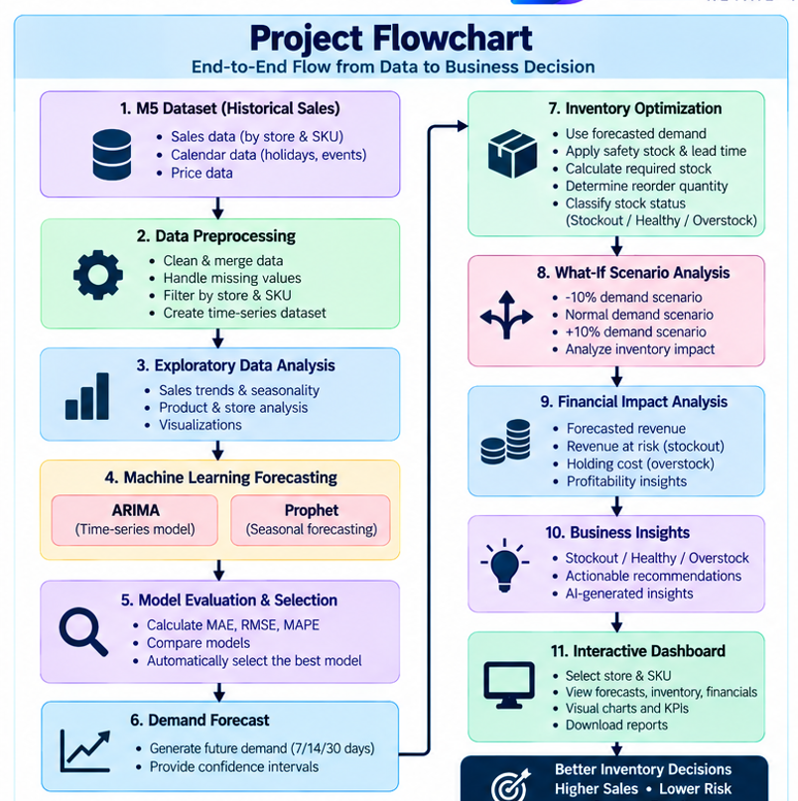
Project Workflow

Slide 10
Project Plan
Phase | Activity | Output
Phase 1 | Literature Survey & Requirement Analysis | Problem definition, objectives, requirements and research gap
Phase 2 | Data Collection & Preprocessing | Cleaned and structured M5 retail sales dataset
Phase 3 | Exploratory Data Analysis | Demand trends, seasonality, product/store patterns and visualizations
Phase 4 | ARIMA & Prophet Model Development | Trained demand forecasting models and future demand predictions
Phase 5 | Model Evaluation & Adaptive Selection | MAE, RMSE, MAPE comparison and selection of the better-performing model
Phase 6 | Inventory & What-If Analysis | Stock risk detection, reorder recommendation and financial impact analysis
Phase 7 | Dashboard Development, Testing & Validation | Integrated Streamlit dashboard with forecasting and decision-support outputs
Phase 8 | Documentation & Final Demonstration | Project report, results, conclusions and working prototype

Slide 11
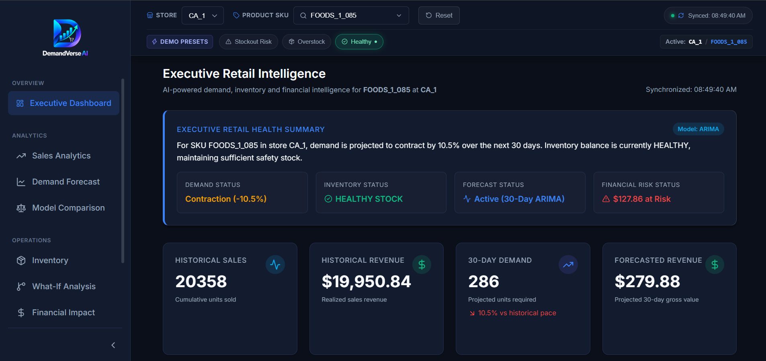
Project Outcome

Slide 12
THANK YOU

